Slide 1
COMP90038 ALGORITHMS AND COMPLEXITY
Tutorial Week 9
AVL trees, 2–3 trees, and an algorithm–design problem — working through problems 61 to 65 and 60.
Kenji
Tutor, School of Computing and Information Systems
University of Melbourne

Slide 2
SESSION PLAN
Today's problems
#
TOPIC
WHAT WE'LL DO
61
Binary search tree
Insert eight keys into an empty BST, one at a time
62
AVL tree
Insert nine keys and track every rotation along the way
63
Rotation sequences
Which insertion orders force an LR–rotation, then an RL–rotation?
64
2–3 tree
Build one from the same nine keys as problem 62
65
Insertion order
Does the order you insert keys change the final 2–3 tree?
60
Design problem
Placing numbers into boxes to satisfy a chain of inequalities
COMP90038 · Tutorial 9
AGENDA

Slide 3
AVL TREES
Balance by rotation
An AVL tree is a binary search tree that re–balances itself after every insertion, so lookups, insertions and deletions all stay logarithmic — no matter what order the keys arrive in.
Balance factor
Must stay in {−1, 0, 1}
Θ(log n) height
height(left) − height(right)
A node whose balance factor lands outside this range triggers a rotation to bring it back.
Guaranteed for a tree of n nodes, however it was built — that's the whole point.
Recomputed at every node, every time a key is inserted or removed.
COMP90038 · Tutorial 9
AVL TREES

Slide 4
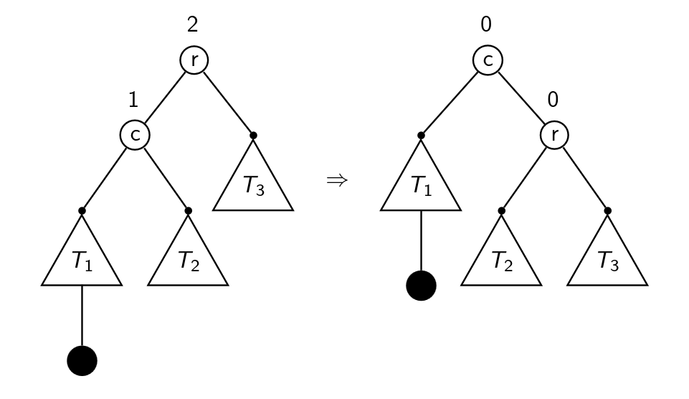
AVL REBALANCING
Single rotations
One R–rotation fixes a Right–Right imbalance at r — an L–rotation mirrors it for Left–Left.
COMP90038 · Tutorial 9
AVL TREES

Slide 5
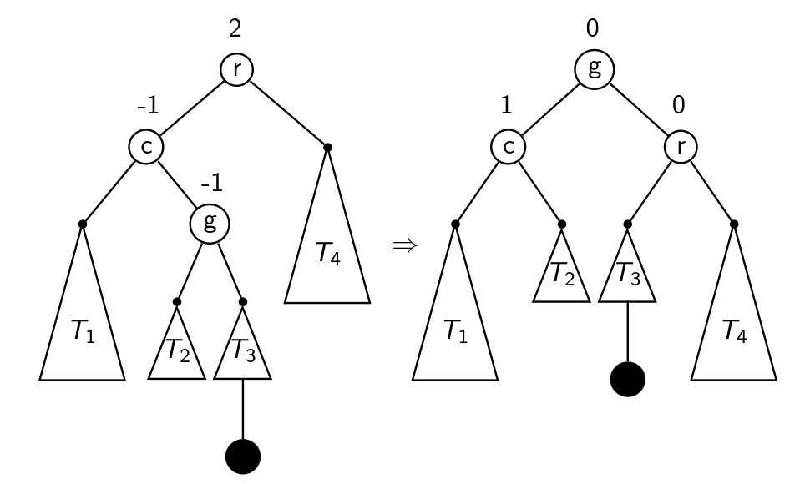
AVL REBALANCING
Double rotations
An LR–rotation fixes the zig–zag left–then–right imbalance at r — an RL–rotation mirrors it for right–then–left. g always ends up as the new root.
COMP90038 · Tutorial 9
AVL TREES

Slide 6
AVL REBALANCING
Four insertion cases
After inserting a node u, let v be the lowest node on the path back to the root whose balance factor now breaks {−1, 0, 1}. Where u sits, relative to v, decides the fix.
CASE
WHERE U LANDS
FIX
Left–Left
Left subtree of the left child of v
R–rotation at v
Right–Right
Right subtree of the right child of v
L–rotation at v
Left–Right
Right subtree of the left child of v
LR–rotation at v
Right–Left
Left subtree of the right child of v
RL–rotation at v
COMP90038 · Tutorial 9
AVL TREES

Slide 7
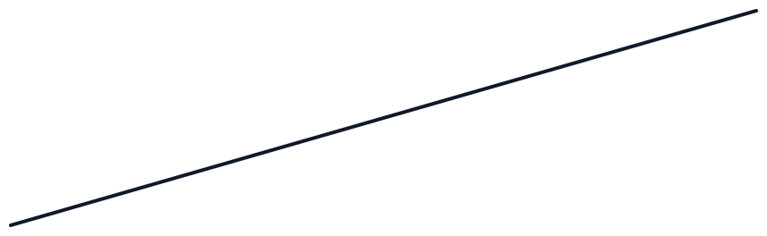
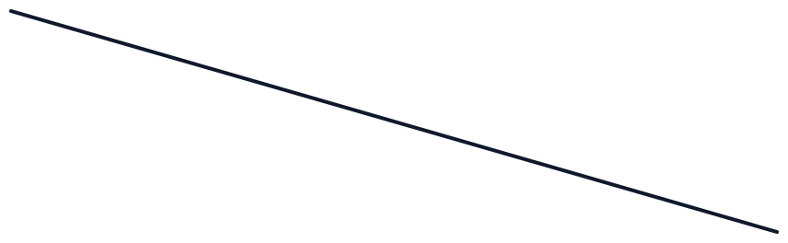
2–3 TREES
Multi–way balance
A search tree whose nodes can hold one or two items. Every leaf sits at the same depth, so height — and search time — stays Θ(log n) automatically, with no rotations at all.
G
O
keys < G
G < keys < O
keys > O
COMP90038 · Tutorial 9
2–3 TREES

Slide 8
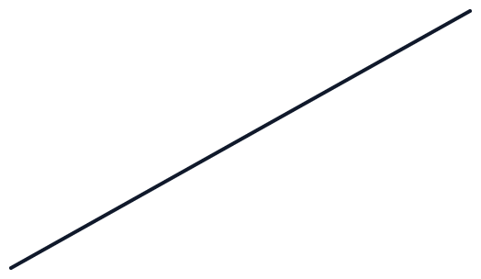
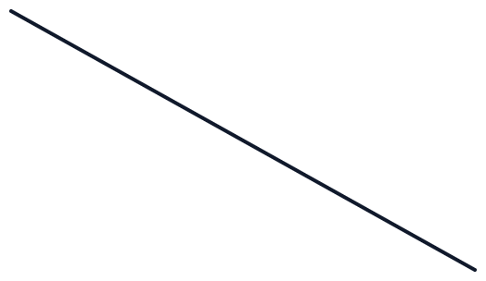

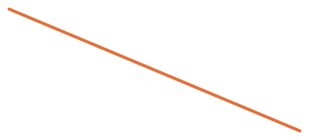



2–3 TREES
Insertion by splitting
Search to a leaf and add the key. An overflowing leaf splits, pushing its middle key up to the parent.
Before — a leaf overflows
After — 5 pushed up, root splits too
3
8
5
3
8
2
4
5
7
9
2
4
7
9
COMP90038 · Tutorial 9
2–3 TREES

Slide 9

PROBLEM 61
Binary search tree
Starting from an empty tree, insert these keys in the given order and draw the resulting BST.
17
19
13
26
14
18
21
24
Reminder: at each node, a smaller key goes left, a larger key goes right — keep walking until an empty spot opens up.
COMP90038 · Tutorial 9
PROBLEM 61

Slide 10

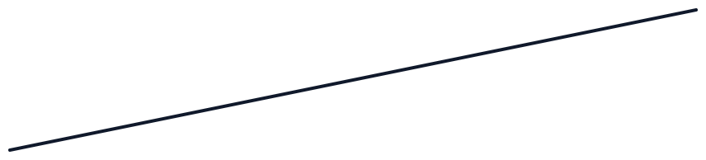
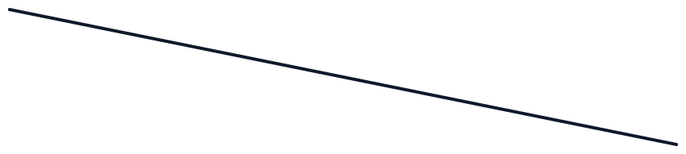
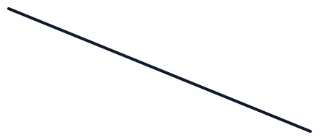
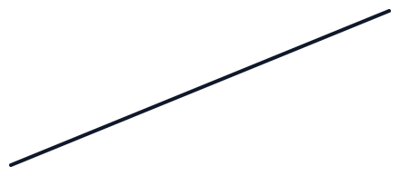
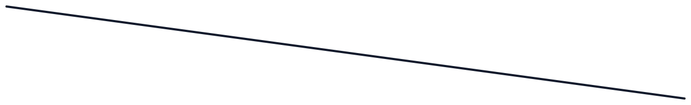
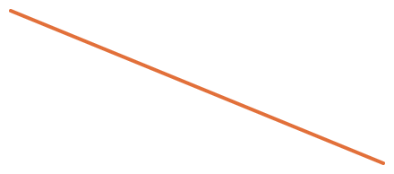

INSERT: 17, 19, 13, 26, 14, 18, 21, 24
Problem 61 — solution
17
13
19
14
18
26
21
24
COMP90038 · Tutorial 9
PROBLEM 61

Slide 11
PROBLEM 62
AVL tree
Starting from an empty tree, insert these keys in the given order, rebalancing with rotations whenever the AVL property breaks.
A
L
G
O
R
I
T
H
M
After each insertion, walk back up to the root. The first node whose balance factor leaves {−1, 0, 1} gets rotated.
COMP90038 · Tutorial 9
PROBLEM 62

Slide 12
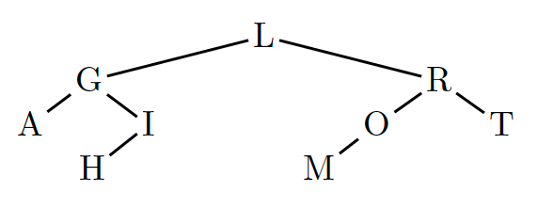
INSERT: A, L, G, O, R, I, T, H, M
Rotations along the way: L–rotation (at R) → RL–rotation (at I) → L–rotation (at T)
Problem 62 — solution
COMP90038 · Tutorial 9
PROBLEM 62

Slide 13
PROBLEM 63
Rotation sequences
Five distinct keys k₁ < k₂ < k₃ < k₄ < k₅ can be inserted into an empty AVL tree in 120 different orders.
For exactly two of those 120 orders, insertion triggers
an LR–rotation, then an RL–rotation
Which two orders are they?
COMP90038 · Tutorial 9
PROBLEM 63

Slide 14
PROBLEM 63 — SOLUTION
Exactly two orders work
3, 1, 2, 5, 4
5, 1, 4, 3, 2
Work without loss of generality on {1, 2, 3, 4, 5}. After three keys are inserted, an AVL tree of three nodes must already be perfectly balanced — so the first three keys have to trace the "⟨" zig–zag shape that an LR–rotation fixes.
The remaining two keys must then trace the mirrored "⟩" zig–zag, which an RL–rotation fixes. Only two orderings of five keys satisfy both shapes in sequence.
COMP90038 · Tutorial 9
PROBLEM 63

Slide 15
PROBLEM 64
2–3 tree
The same nine keys as problem 62 — but now inserted, in the same order, into an empty 2–3 tree.
A
L
G
O
R
I
T
H
M
No balance factors, no rotations — just split an overflowing leaf and push its middle key up, as needed.
COMP90038 · Tutorial 9
PROBLEM 64

Slide 16
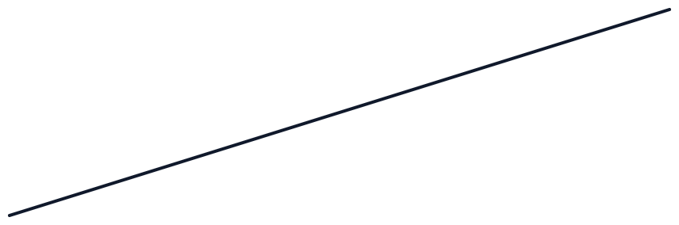
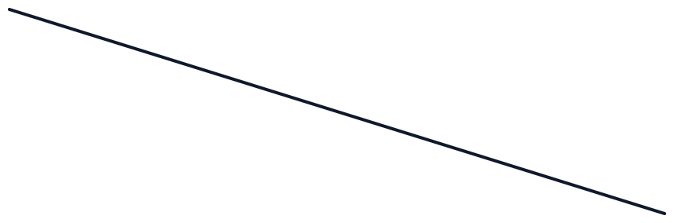


INSERT: A, L, G, O, R, I, T, H, M
Problem 64 — solution
I
G
O
A
H
L
M
R
T
COMP90038 · Tutorial 9
PROBLEM 64

Slide 17
PROBLEM 65
Insertion order
Build a 2–3 tree by inserting 1, 2, 3, 4, 5 in that order. Then build another by inserting 2, 3, 4, 5, 1.
?
Are the two trees identical?
?
Across all 120 orderings of {1, 2, 3, 4, 5}, how many different 2–3 trees can result?
COMP90038 · Tutorial 9
PROBLEM 65

Slide 18
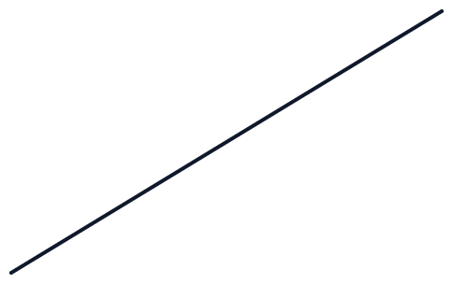
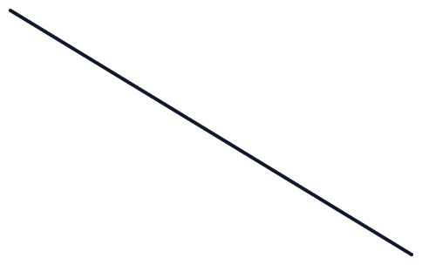


PROBLEM 65 — SOLUTION
Two different shapes
Insert 1, 2, 3, 4, 5
Insert 2, 3, 4, 5, 1
2
4
3
1
3
5
1
2
4
5
Not identical — the same keys, inserted in a different order, build a different tree.
COMP90038 · Tutorial 9
PROBLEM 65

Slide 19
PROBLEM 65 — SOLUTION
Only two trees are possible
In any 2–3 tree, a non–leaf 2–node must have exactly 2 children, and a non–leaf 3–node must have exactly 3. The root of a 5–key tree is either a 2–node or a 3–node — check both.
Root is a 2–node
Root is a 3–node
It must have 2 children, so it needs one key with exactly 2 keys smaller and 2 keys larger. Only 3 fits: 1, 2 < 3 < 4, 5. Exactly one tree.
It must have 3 children, so its two keys need 1, 2, and 2 keys either side. Only 2, 4 fits: 1 < 2 < 3 < 4 < 5. Exactly one tree.
COMP90038 · Tutorial 9
PROBLEM 65

Slide 20
PROBLEM 60
Numbers into boxes
Given a list of n distinct integers and a row of n boxes with fixed inequality signs between them, design an algorithm that places the numbers into the boxes so every inequality holds.
<
>
<
<
for example, with the numbers 4, 6, 3, 1, 8:
1
<
8
>
3
<
4
<
6
Some instances have several valid placements — we only need an algorithm that is guaranteed to find one.
COMP90038 · Tutorial 9
PROBLEM 60

Slide 21
PROBLEM 60 — SOLUTION
Sort once, then fill greedily
1
Sort the n numbers.
2
Walk the boxes left to right, looking at the sign right after each one.
3
If a "<" follows: remove the smallest remaining number and place it in the box.
4
If a ">" follows: remove the largest remaining number and place it in the box.
5
Place the one number left over in the final box.
COMP90038 · Tutorial 9
PROBLEM 60

Slide 22
PROBLEM 60 — SOLUTION
Why it works, and how fast
O(n²)
Correctness, by induction
if the list is unsorted — finding the min or max costs O(n), done n times
Base case: one box, one number — trivially correct.
Inductive step: assume the first n−1 boxes are filled correctly. For the last box, we take the overall largest or smallest number still left — so whatever its neighbour holds, that extreme value satisfies the inequality.
O(n log n)
once sorted first — every extraction is then O(1), so the sort dominates
COMP90038 · Tutorial 9
PROBLEM 60

